Slide 1
AKI in Lassa fever

Slide 2
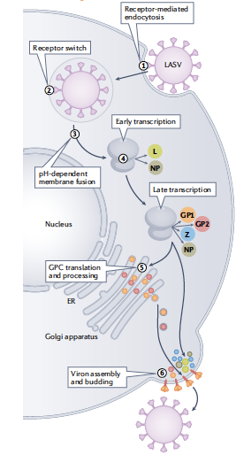
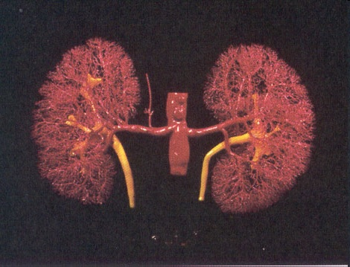
Lassa virus replication

Slide 3
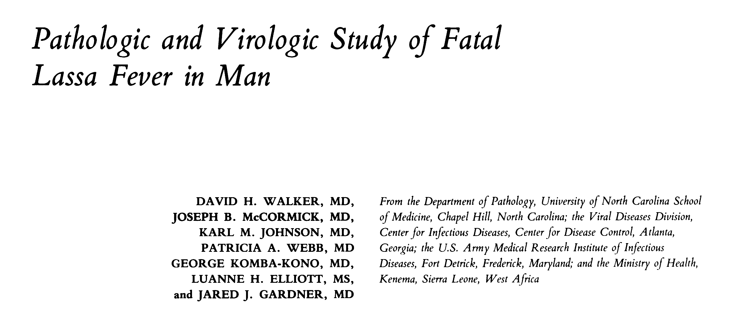
Lassa virus and kidney
Patients with Lassa fever in 1976 – 1980 in Sierra Leone:
Complete postmortem examination of 6 patients
Tissues from 7 fetuses from women infected with Lassa virus
Postmortem biopsies from additional 18 patients

Slide 4
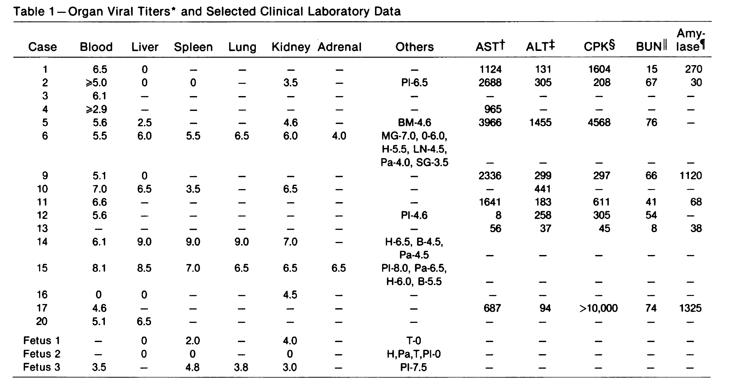
Lassa virus and kidney

Slide 5
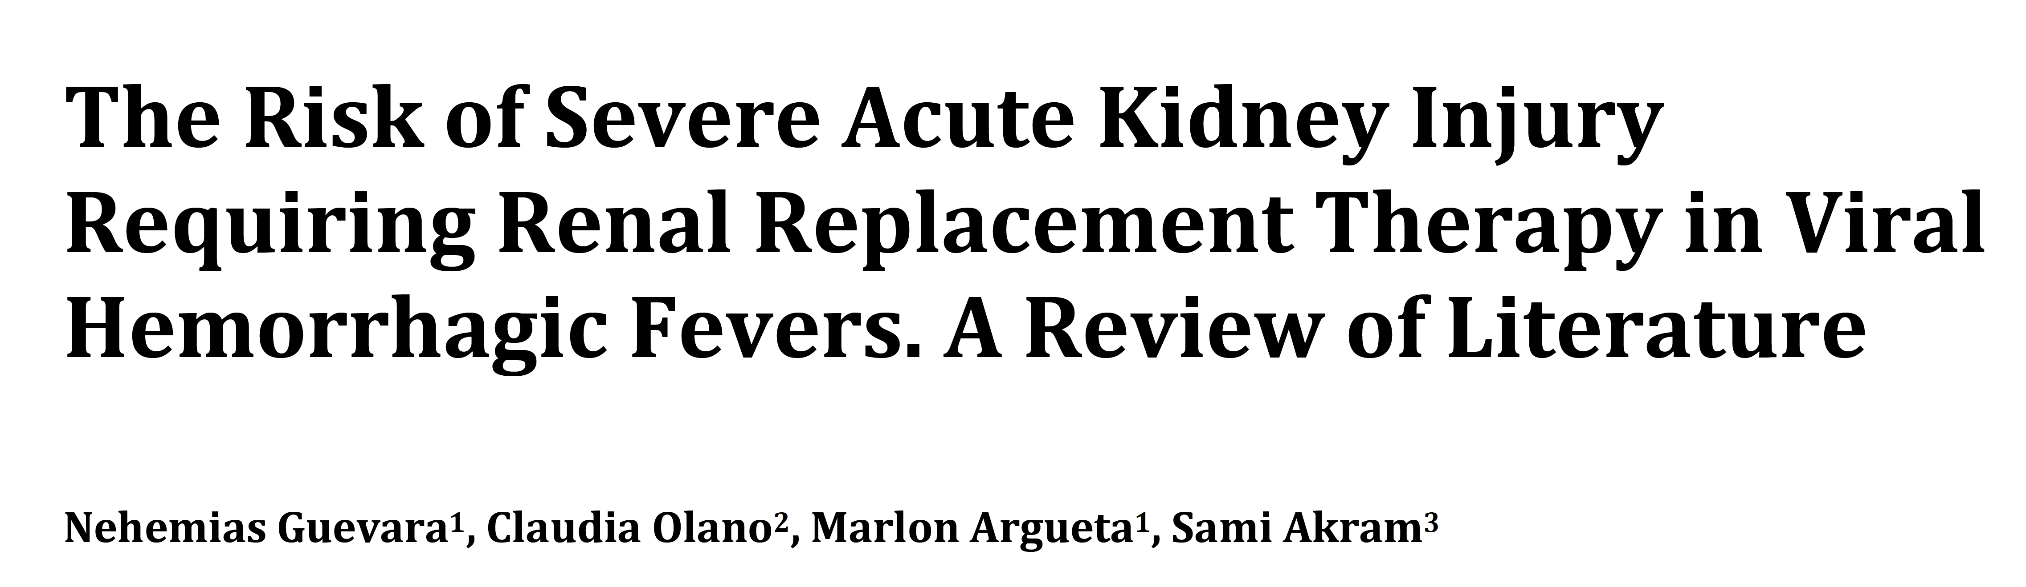
Lassa fever infection and AKI
Literature search: PubMed search of the English literature from 1999 – 2019 using the term ‘viral hemorrhagic fever’ and ‘renal failure’ as the subject
74 publications, 78 patients
70% dengue and hantavirus infection
remainder: puumala virus, Ebola virus, Lassa fever infection
Overall mortality: 32.2%

Slide 6
Lassa fever infection and AKI
Pathophysiology of AKI in viral hemorrhagic fever
Multifactorial:
Hypovolemia
hemodynamic instability
rhabdomyolysis
nephrotoxicity
direct cytopathic effects of the viral protein on the glomerular & tubular cells
Treatment:
supportive
no specific therapy

Slide 7
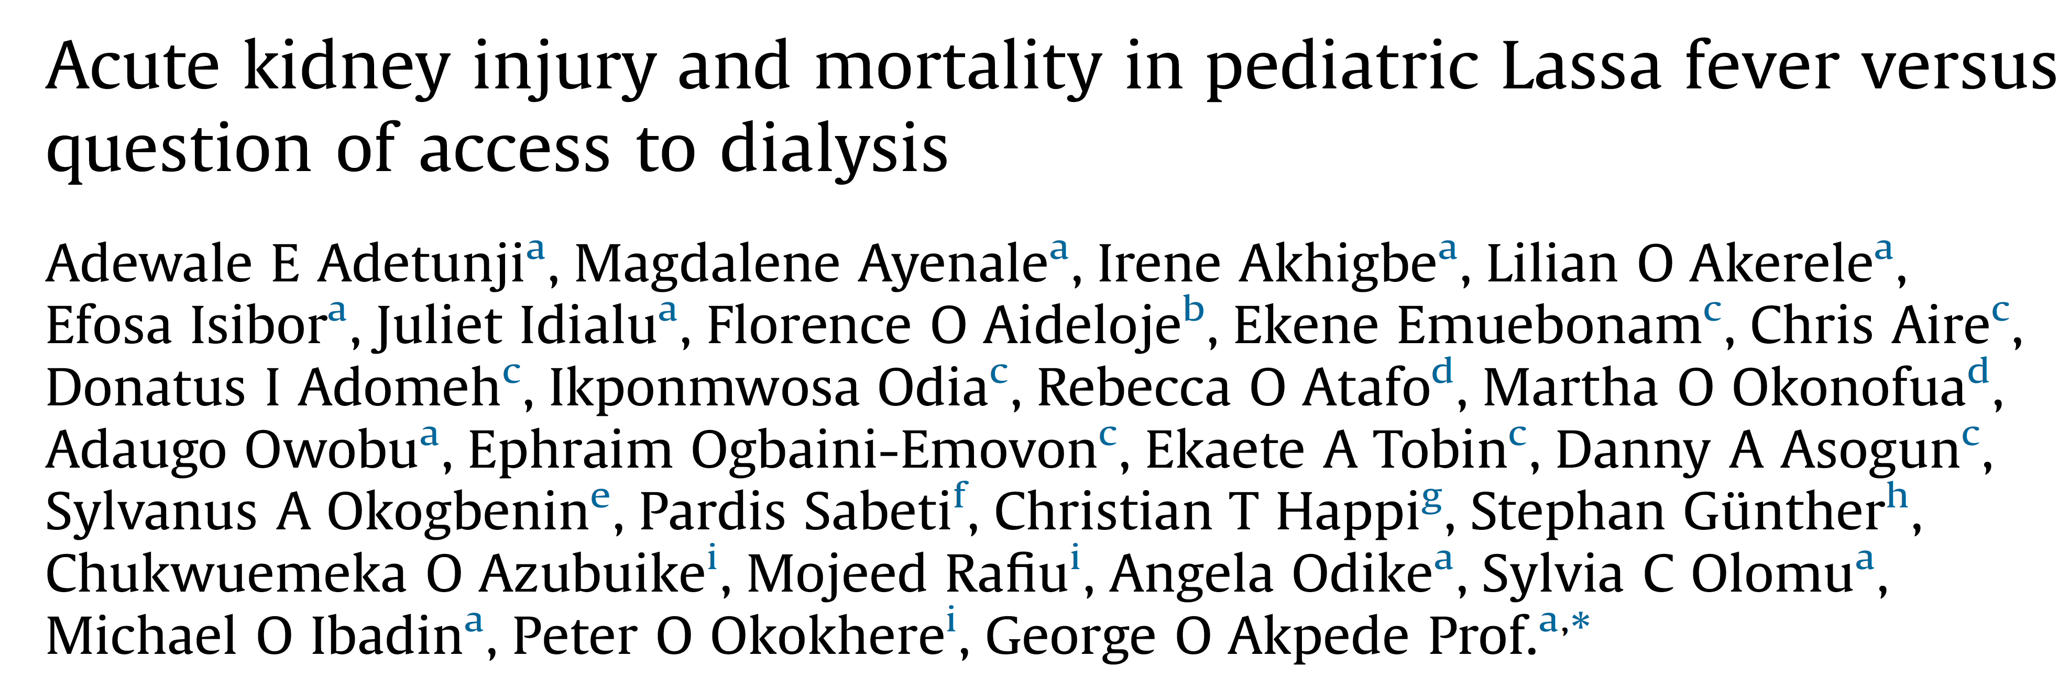
Lassa fever infection and AKI in children
40 successive hospitalized children with confirmed Lassa fever between 2009 – 2017 in Nigeria
40% had AKI (mainly AKI stage 2 or 3)
Risk factors for AKI: abnormal bleeding
encephalopathy
hamaturia
elevated transaminases

Slide 8
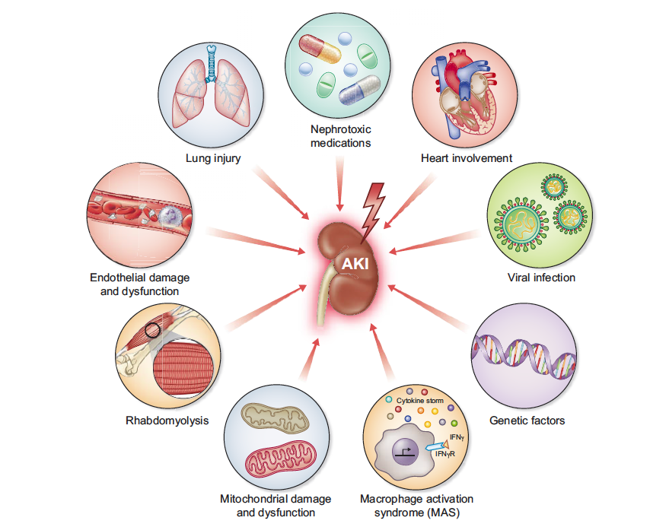
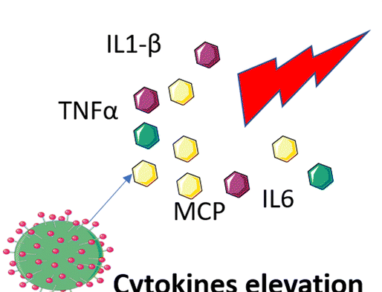
Lassa fever infection and risk of AKI

Slide 9
Lassa fever infection and AKI
Pathophysiology
Indirect Effects:
Hypovolemia
Systemic inflammation
Secondary infection
Rhabdomyolysis
Management Effects:
Nephrotoxins
Fluid management
Direct Viral Effects:
Kidney infection
Management
Lassa fever associated AKI is often multi-factorial.
The risk of AKI is higher in patients with more severe Lassa infection.
There are no specific treatments for Lassa fever associated AKI.
Standard of care to prevent and manage severe infections and multi-organ failure in critically ill patients is recommended.
Fluid management is important.
Exposure to nephrotoxins should be avoided if possible.
The indications for RRT are not different than for other infection associated types of AKI

